Slide 1
UNIVERSITY INSTITUTE OF COMPUTING
MASTER OF COMPUTER APPLICATIONS
PYTHON PROGRAMMING
21CAH-653
DISCOVER . LEARN . EMPOWER

Slide 2

Syllabus
Unit-I
Introduction to Python and Basics: Setting up programming environment, Python on different operating systems, Variables, data types.
Introduction Python Data Structures: Lists-Accessing elements, Index position, Using individual values from a list, Changing/Adding and removing Elements, Organizing a list, Loop through an entire list, Avoiding Indentation Error, Numerical Lists, Sub-list, List comprehension, Tuple, Set, Dictionary- Working with dictionaries, Looping through dictionaries, Nesting, Dictionary comprehension.
Flow Control Constructs: Conditional Statements: If, If Else, Nested If, elif, Switch; Looping: For, While, Nested loops, Jumping statements: Break, Continue and Pass.
Python Function: Passing arguments, Return Values, Passisng a list, Passing an Arbitrary number of arguments, Function in Modules, Recursive function, Nested functions, Default and flexible arguments, Lambda function, Map() function, Filter function, Reduce() function
Classes: Creating and using a class, Working with classes and Instances, Inheritance, Importing Classes, Python standard library.

Slide 3
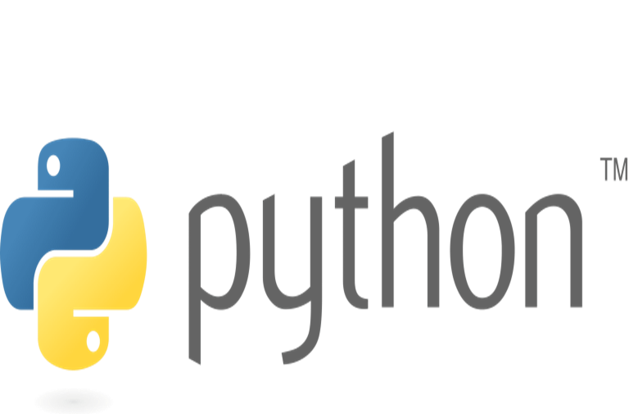
Contents
Python Function
Passing arguments
Return Values
Passing a list
Passing an Arbitrary number of arguments
Function in Modules
Recursive function
Nested functions
Default and flexible arguments
Lambda function, Map() function, Filter function, Reduce() function

Slide 4
Python Function
Function provide a way to break problems or processes down into smaller and independent blocks of code.
Functions can be used to define reusable code and organize and simplify code.
Function is a block of code which performs a specific task.
Function improves efficiency and reduces errors because of the reusability of a code.

Slide 5
Python Function
Types of Functions : Python support two types of functions:
Built-in function : The functions which are come along with Python itself are called a built-in function or predefined function. Some of them are listed below.
range(), id(), type(), print(), input(), eval() etc.
User-defined function: Functions which are created by programmer explicitly according to the requirement are called a user-defined function.

Slide 6
Python Function
Defining a Function: A function definition consists of the function’s name, parameters, and body.
The syntax for defining a function is as follows:
def functionName(list of parameters):
# Function body
def: def is a keyword for defining a function.
FunctionName: Function name is the name of the function that can be give any name to function. A function name to uniquely identify the function.
List of parameters: Arguments through which pass values to a function. They are optional.
A colon (:) to mark the end of the function header.

Slide 7
Python Function
Calling a Function: Calling a function executes the code in the function.
To call a function, use the name of the function with the parenthesis, and if the function accepts parameters, then pass those parameters in the parenthesis.
A called function returns control to the caller when its return statement is executed or the function is finished.
Return Statement: The return statement is used to exit a function and go back to the place from where it was called. Syntax of return: return [expression_list]
This statement can contain an expression that gets evaluated and the value is returned.
If there is no expression in the statement or the return statement itself is not present inside a function, then the function will return the nothing object.

Slide 8
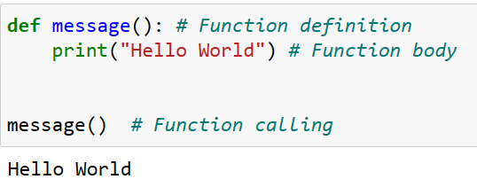
Python Function
Example:

Slide 9
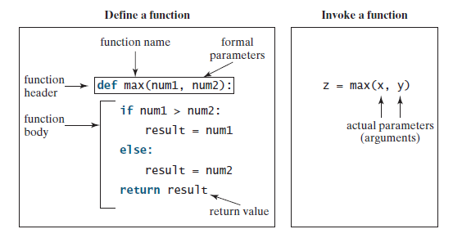
Python Function
Example:

Slide 10
Python Function
Formal Parameters: The variables in the function header are known as formal parameters or simply parameters.
Actual Parameter : When a function is invoked, you pass a value to the parameter. This value is referred to as an actual parameter or argument. Parameters are optional; that is, a function may not have any parameter.

Slide 11
Python Function
Scope and Lifetime of Variables: Scope of a variable is the portion of a program where the variable is recognized. Parameters and variables defined inside a function are not visible from outside the function. Hence, they have a local scope.
The lifetime of a variable is the period throughout which the variable exits in the memory. The lifetime of variables inside a function is as long as the function executes.
They are destroyed once we return from the function. Hence, a function does not remember the value of a variable from its previous calls.
A Global variable is a variable that declares outside of the function. The scope of a global variable is broad. It is accessible in all functions of the same module.

Slide 12
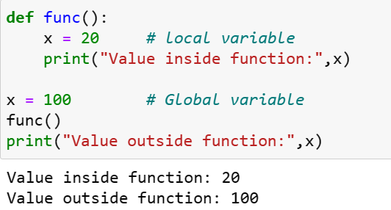
Python Function
Example of local and global variables:

Slide 13
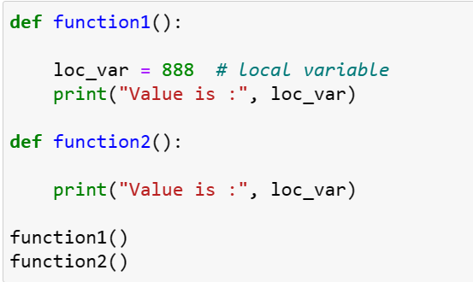
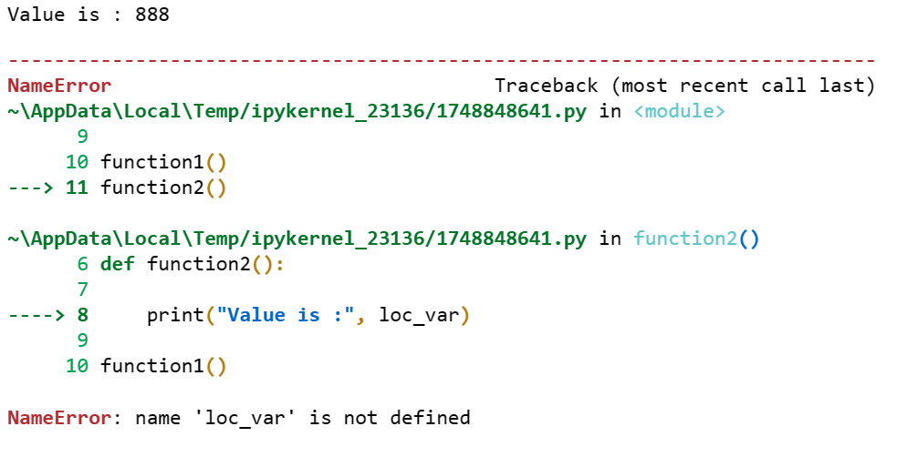
Python Function

Slide 14
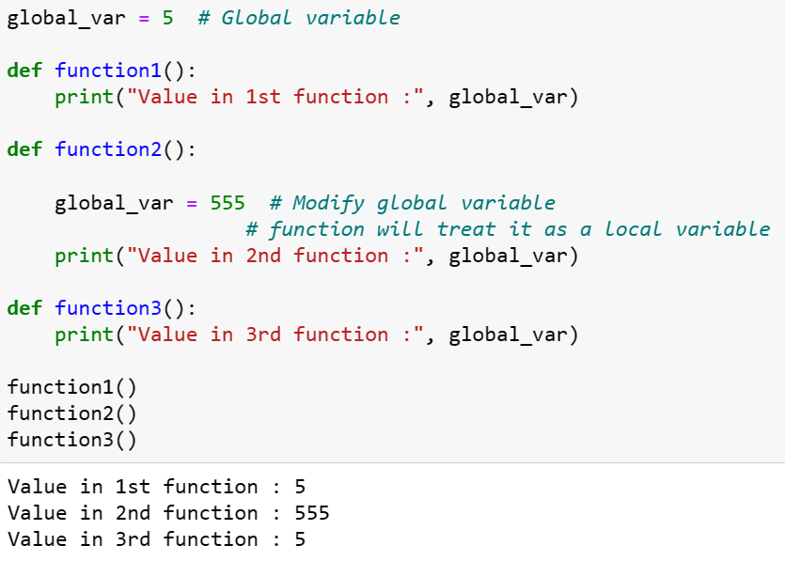
Python Function
Example of local and global variables:

Slide 15
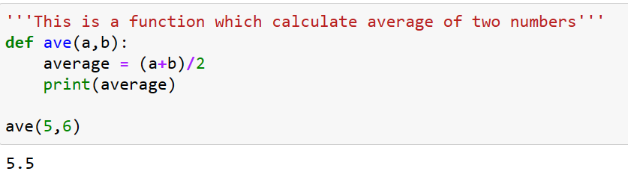
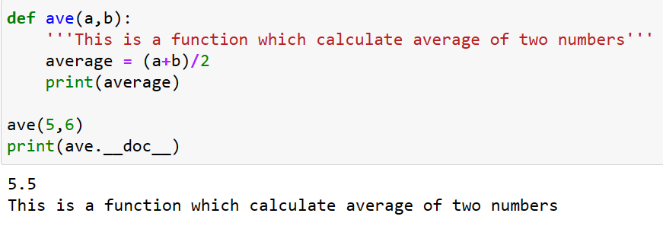
Python Function
Docstring: Python docstrings are strings used right after the definition of a function, method, class, or module. They are used to document the code.
To access the docstrings using the __doc__ attribute.

Slide 16
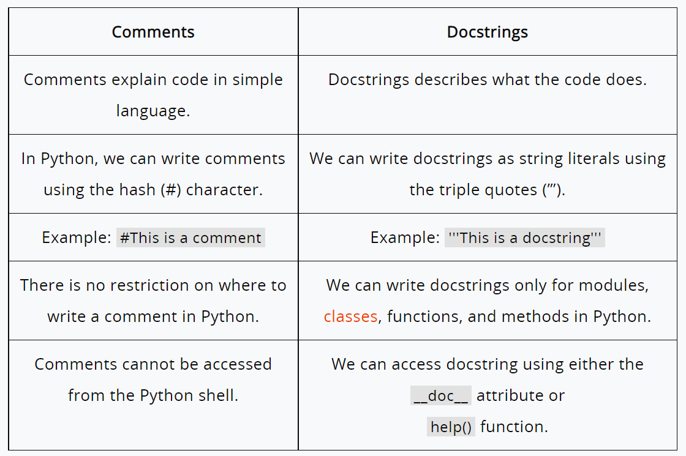
Python Function
Difference between comments and docstring

Slide 17
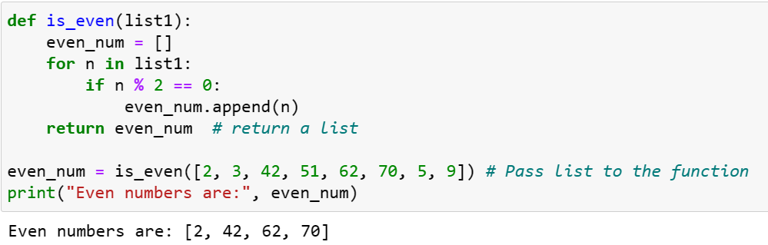
Python Function
Return Value From a Function: In Python, to return value from the function, a return statement is used. It returns the value of the expression following the returns keyword. The return statement should be inside of the function block. (function with list)

Slide 18
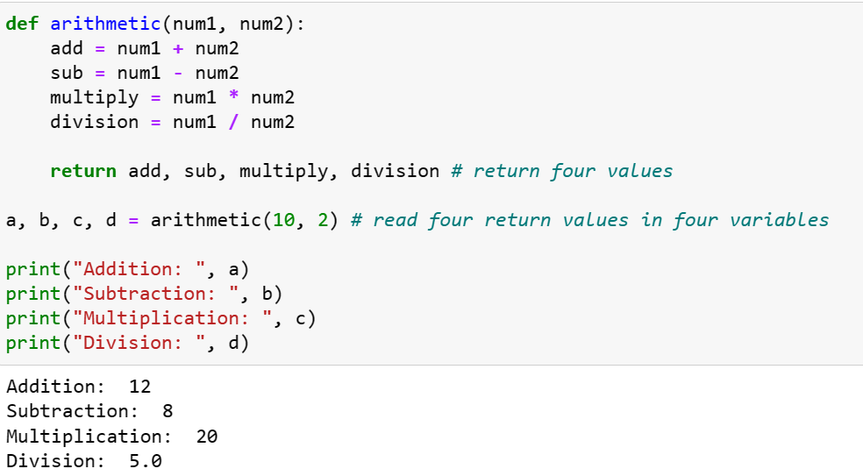
Python Function
Return Multiple Values: It return multiple values from a function. Use the return statement by separating each expression by a comma.

Slide 19
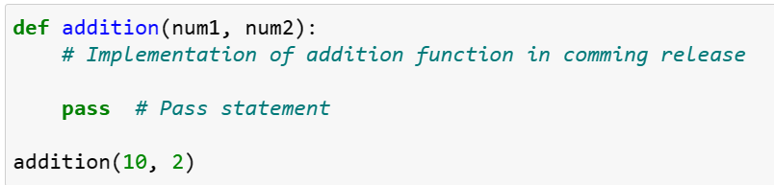
Python Function
pass Statement in function: When the interpreter finds a pass statement in the program, it returns no operation.

Slide 20
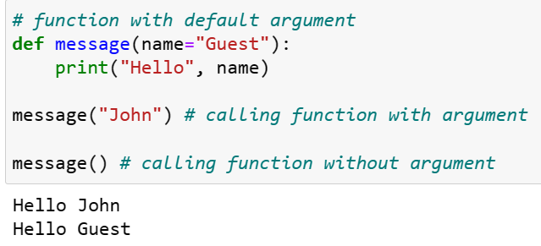
Python Function
Default Arguments: Function arguments can have default values in Python. Default value to an argument in function definition using the = assignment operator.

Slide 21
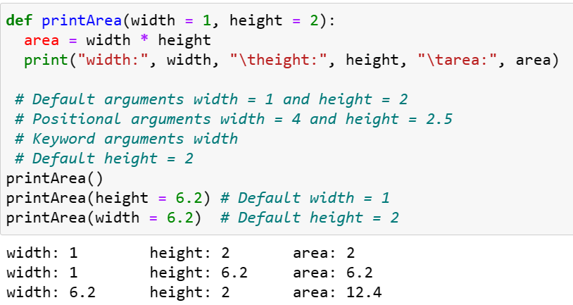
Python Function
Default Arguments

Slide 22
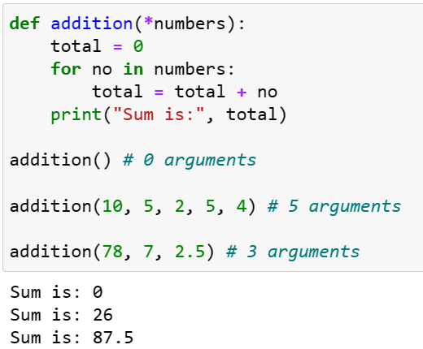
Python Function
Arbitrary Arguments: Sometimes, we do not know in advance the number of arguments that will be passed into a function. Python allows us to handle this kind of situation through function calls with an arbitrary number of arguments. In the function definition, we use an asterisk (*) before the parameter name to denote this kind of argument.

Slide 23
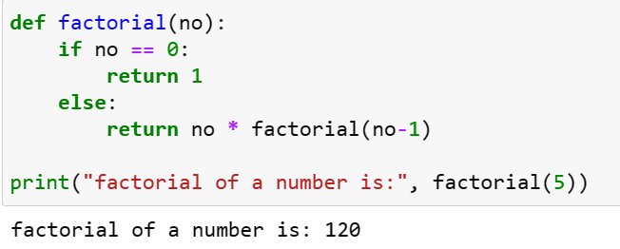
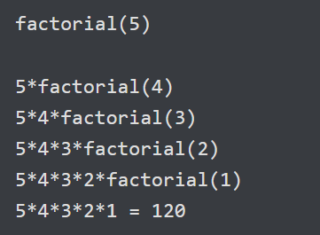
Python Function
Recursive Function: A recursive function is a function that calls itself, again and again.
Consider, calculating the factorial of a number is a repetitive activity, in that case, we can call a function again and again, which calculates factorial.

Slide 24
Python Function
Lambda Functions: In Python, an anonymous function is a functions that is defined without a name.
While normal functions are defined using the def keyword in Python, anonymous functions are defined using the lambda keyword.
Hence, anonymous functions are also called lambda functions.
Syntax: Lambda arguments: expression
Lambda functions can have any number of arguments but only one expression. The expression is evaluated and returned.
Lambda functions can be used wherever function objects are required.

Slide 25
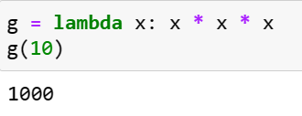
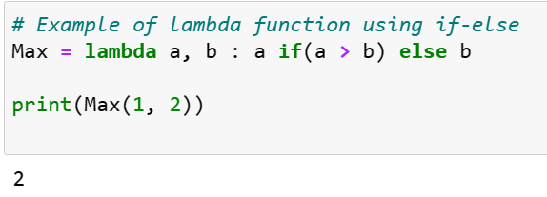
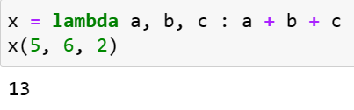
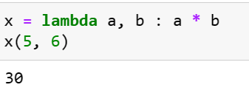
Python Function
Lambda Functions

Slide 26
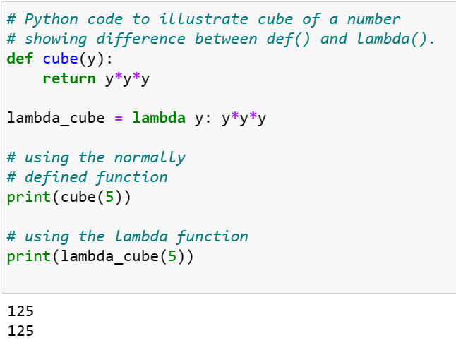
Python Function
difference between def() and lambda() function

Slide 27
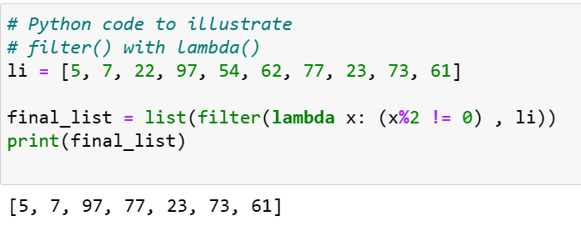
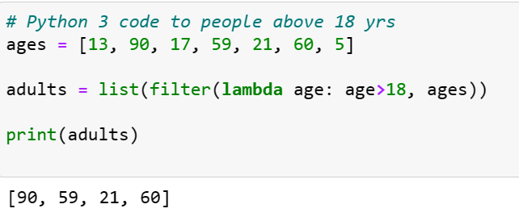
Python Function
Using lambda() Function with filter(): The filter() function in Python takes in a function and a list as arguments. This offers an elegant way to filter out all the elements of a sequence “sequence”, for which the function returns True. Here is a small program that returns the odd numbers from an input list:

Slide 28
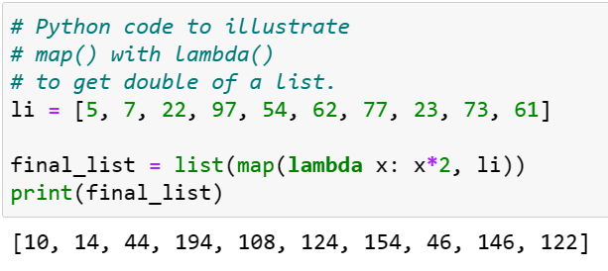
Python Function
Using lambda() Function with map(): The map() function in Python takes in a function and a list as an argument. The function is called with a lambda function and a list and a new list is returned which contains all the lambda modified items returned by that function for each item. Example:

Slide 29
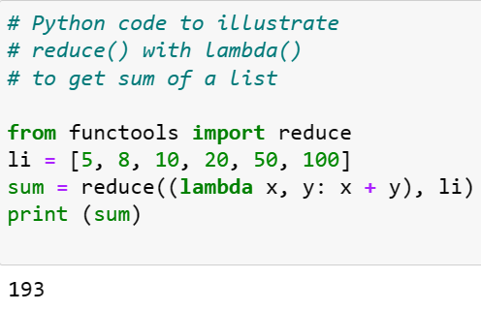
Python Function
Using lambda() Function with reduce(): The reduce() function in Python takes in a function and a list as an argument. The function is called with a lambda function and an iterable and a new reduced result is returned. This performs a repetitive operation over the pairs of the iterable. The reduce() function belongs to the functools module.

Slide 30
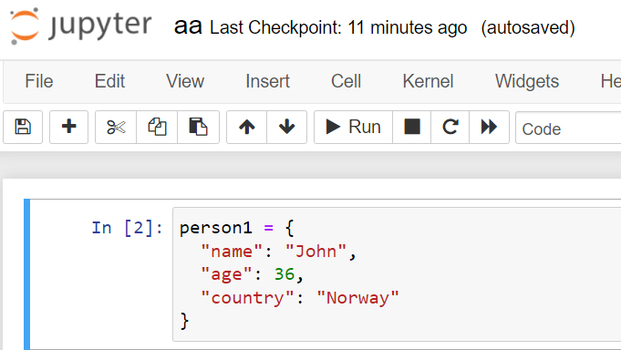
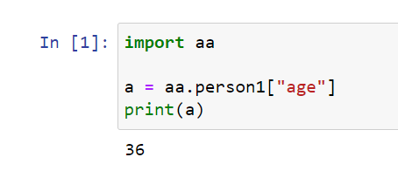
Python Function
Modules in Function: A file containing a set of functions you want to include in your application.
Create a Module: To create a module just save the code you want in a file with the file extension .py
Example

Slide 31
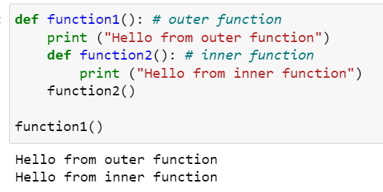
Python Function
Nested Function: A nested function is simply a function within another function, and is sometimes called an "inner function".
Defining an Inner Function: o define an inner function in Python, we simply create a function inside another function using the Python’s def keyword.

Slide 32
Python Function
Data encapsulation: There are times when you want to prevent a function or the data it has access to from being accessed from other parts of your code, so you can encapsulate it within another function.
When you nest a function like this, it's hidden from the global scope. Because of this behavior, data encapsulation is sometimes referred to as data hiding or data privacy.

Slide 33
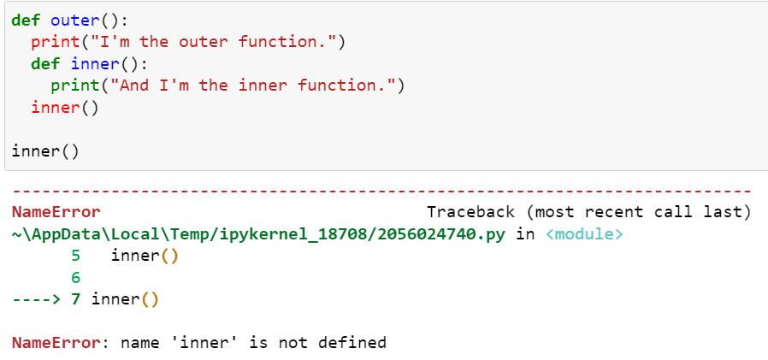
Python Function
Data Encapsulation

Slide 34
THANK YOU

